Slide 1

Software Design (swD392)
Ch05 – Overview of Software Modeling and Design Methods

Slide 2
Main Contents
COMET Overview
COMET Use Case-Based Software Life Cycle
COMET Life Cycle vs Other Software Processes
Requirements, Analysis, and Design Modeling
Designing Software Architecture

Slide 3
COMET Overview
COMET: Collaborative Object Modeling and Architectural Design Method
COMET is an iterative use case–driven and object-oriented method
COMET uses the UML notation
COMET = UML + Method

Slide 4
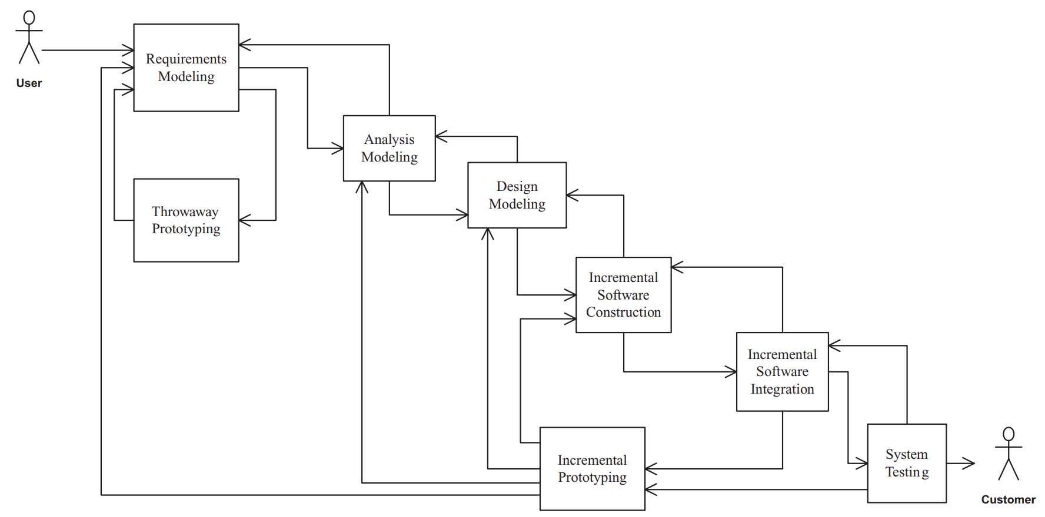
COMET Use Case-Based Software Life Cycle
The COMET UC–based software life cycle model is a highly iterative software development process based around the use case (UC) concept
Notes:
﻿Collaborative Object Modeling and Architectural Design Method

Slide 5
COMET Use Case-Based Software Life Cycle
﻿The COMET method ties in the three phases of requirements, analysis, and design modeling by means of a use case–based approach
In the requirements model: functional requirements are described in terms of actors and use cases. Each use case defines a sequence of interactions between one or more actors and the system.
In the analysis model: the use case is realized to describe the objects that participate in the use case and their interactions.
In the design model: the software architecture is developed, describing components and their interfaces.

Slide 6
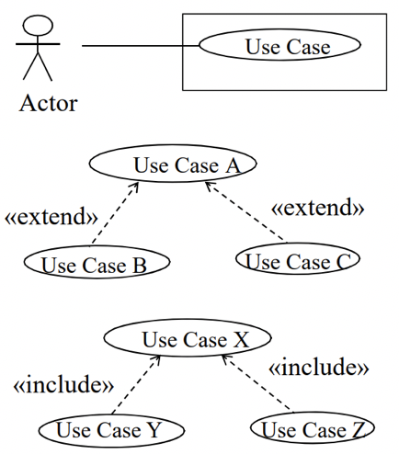
COMET Use Case-Based Software Life Cycle Requirements Modeling
During the requirements modeling phase, a requirements model is developed in which the functional requirements of the system are described in terms of actors and use cases.

Slide 7
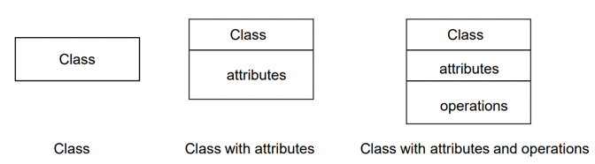
COMET Use Case-Based Software Life Cycle Analysis Modeling 1/2
Static & dynamic models of the system are developed.
﻿The static model defines the structural relationships among problem domain classes.
﻿The classes and their relationships are depicted on class diagrams.
Object structuring criteria are used to determine the objects to be considered for the analysis model.

Slide 8
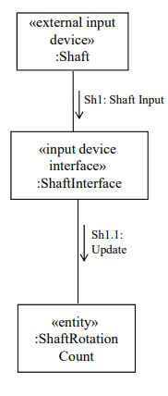
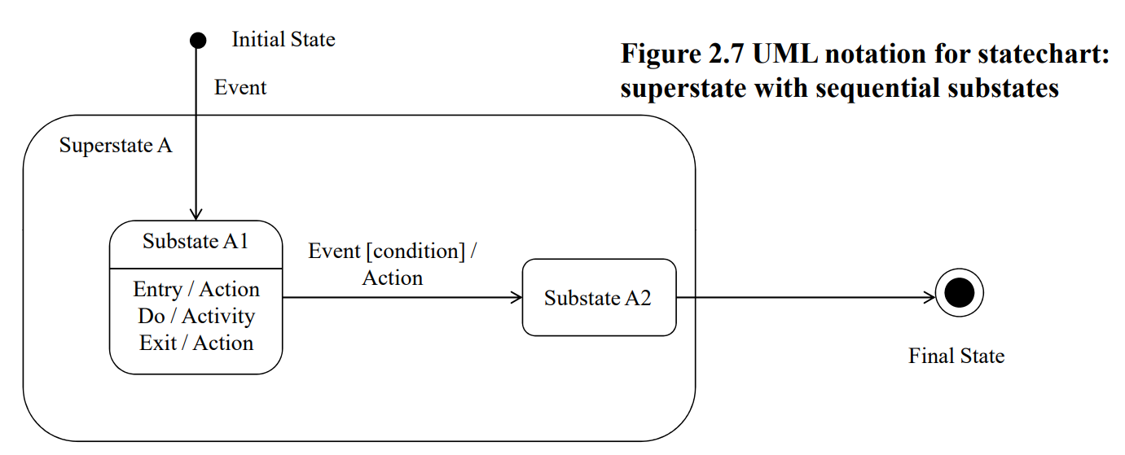

COMET Use Case-Based Software Life Cycle Analysis Modeling 2/2
﻿A dynamic model is then developed in which the use cases from the requirements model are realized to show the objects that participate in each use case and how they interact with each other.
﻿Objects and their interactions are depicted on either communication or sequence diagrams.
State-dependent objects are defined using state charts.

Slide 9
COMET Use Case-Based Software Life Cycle Design Modeling
In the design modeling phase, the software architecture of the system is designed, in which the analysis model is mapped to an operational environment.
The analysis model, with its emphasis on the problem domain, is mapped to the design model, with its emphasis on the solution domain.
For sequential systems, the emphasis is on the object-oriented concepts of information hiding, classes, and inheritance.

Slide 10
COMET Use Case-Based Software Life Cycle Incremental Software Construction
After completion of the software architectural design, an incremental software construction approach is taken.
This approach is based on selecting a subset of the system to be constructed for each increment.
Incremental software construction consists of the detailed design, coding, and unit testing of the classes in the subset.
This is a phased approach by which the software is gradually constructed and integrated until the whole system is built.

Slide 11
COMET Use Case-Based Software Life Cycle Incremental Software Integration
During incremental software integration, the integration testing of each software increment is performed.
The integration test for the increment is based on the use cases selected for the increment.
Integration testing is a form of white box testing, in which the interfaces between the objects that participate in each use case are tested

Slide 12
COMET Use Case-Based Software Life Cycle System Testing
System testing includes the functional testing of the system – namely, testing the system against its functional requirements.
This testing is black box testing and is based on the black box use cases. Thus, functional test cases are built for each black box use case.
Any software increment released to the customer needs to go through the system testing phase.

Slide 13
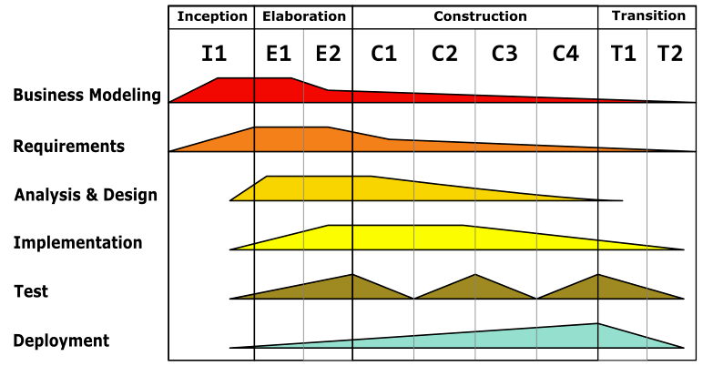
COMET Life Cycle vs Other Software Processes With Unified Software Development Process
The USDP provides considerable detail about the life cycle aspects and some detail about the method to be used.
The workflows of the USDP are the requirements, analysis, design, implementation, and test workflows.
Each phase of the COMET life cycle corresponds to a workflow of the USDP.
The COMET incremental software construction activity corresponds to the USDP implementation workflow.

Slide 14
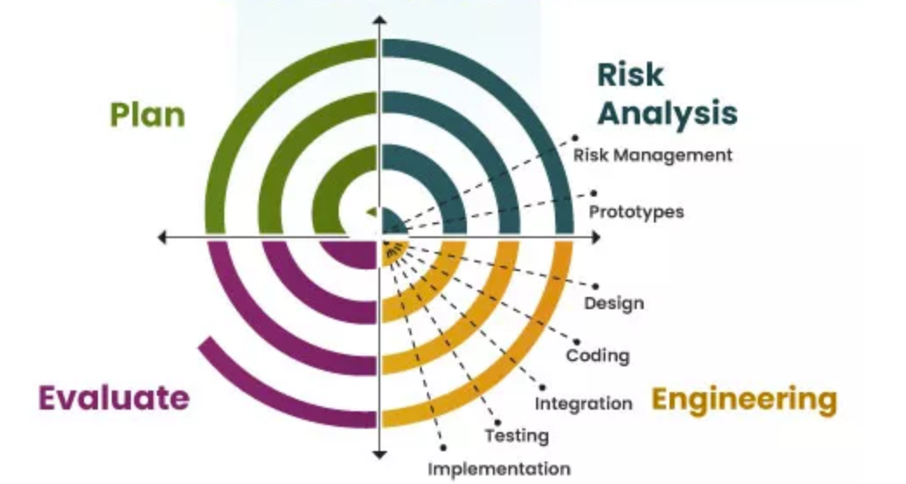
COMET Life Cycle vs Other Software Processes With the Spiral Model
During the project planning for a given cycle of the spiral model, the project manager decides what specific technical activity should be performed in the third quadrant, which is the product development quadrant.
The selected technical activity, such as requirements modeling, analysis modeling, or design modeling, is then performed in the third quadrant
The risk analysis activity, performed in the second quadrant, and cycle planning, performed in the fourth quadrant, determine how many iterations are required through each of the technical activities.
Notes:
https://www.bdtask.com/blog/spiral-model-for-software-development

Slide 15
Requirements, Analysis, and Design Modeling
The UML notation supports requirements, analysis, and design concepts.
The COMET method described in this book separates requirements activities, analysis activities, and design activities.
COMET differentiates analysis from design as follows:
Analysis is breaking down or decomposing the problem so it is understood better;
Design is synthesizing or composing (putting together) the solution.

Slide 16
Requirements, Analysis, and Design Modeling Activities in Requirements Modeling
In the requirements model, the system is considered as a black box. The use case model is developed.
Use case modeling. Define actors and black box use cases.
The use case descriptions are a behavioral view; the relationships among the use cases give a structural view.
Addressing nonfunctional requirements is also important at the requirements phase.

Slide 17
Requirements, Analysis, & Design Modeling Activities in Analysis Modeling
In the analysis model, the emphasis is on understanding the problem; hence, the emphasis is on identifying the problem domain objects and the information passed between them.
As the analysis of the problem domain is considered. The activities in this model are as follows:
Static modeling
Object structuring
Dynamic interaction modeling
Dynamic state machine modeling

Slide 18
Requirements, Analysis, & Design Modeling Activities in Design Modeling
In the design model, the solution domain is considered. During this phase, the analysis model is mapped to a concurrent design model.
Integrate the object communication model.
Make decisions about subsystem structure and interfaces.
Make decisions about what software architectural and design patterns to use in the software architecture.
Make decisions about class interfaces, in particular for sequential software architectures.
Make decisions about how to structure the distributed application into distributed subsystems, in which subsystems are designed as configurable components, and define the message communication interfaces between the components.
Make decisions about the characteristics of objects, particularly whether they are active or passive.
Make decisions about the characteristics of messages, particularly whether they are asynchronous or synchronous

Slide 19
Designing Software Architecture
During software design modeling, design decisions are made relating to the characteristics of the software architecture.
Object-Oriented Software Architectures.
Client/Server Software Architectures.
Service-Oriented Architectures.
Distributed Component-Based Software Architectures.
Real-Time Software Architectures.
Software Product Line Architectures.

Slide 20


